Slide 1
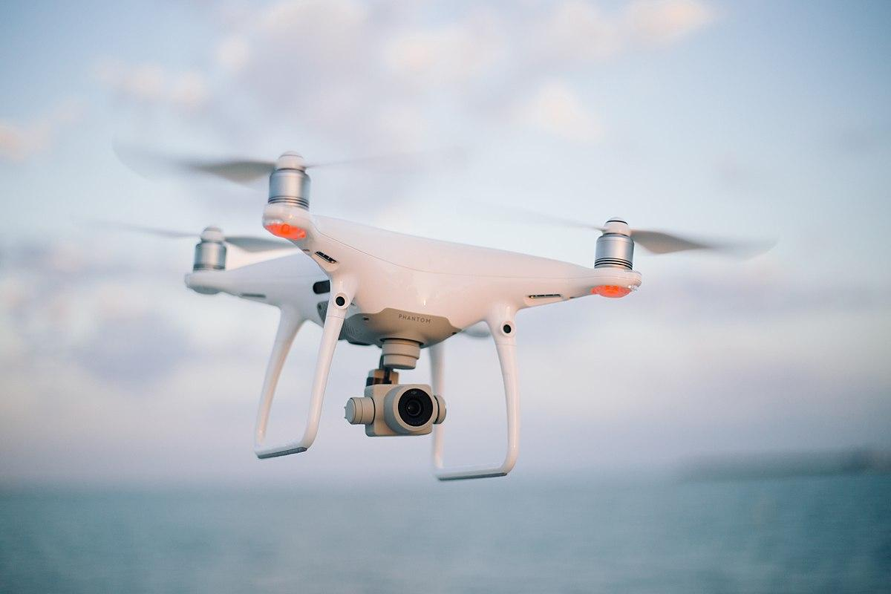

17/06/2021 Gesture recognition for drone search and rescue
Academic advisor: Dr. Jessica Cauchard
Project members: Pelleg Namdar, Roni Dayagi

Slide 2
Overview
Project overview
Background
Planning
Implementing
Conclusions
Notes:
So the point we are going to discuss now are firstly a bit of an overview of the project, we will show some background and the motivation for our project,
How we planned to execute the project,
The main work we have done
And our conclusions from the project and research

Slide 3
Human-Drone interaction
Hand Gesture
Informative
Interface
Depth camera
Commu-nication
Notes:
Some overview of our project:
So, our project is a continues of a project from last year
Our study handle the communication between humans and drones using a depth camera for hand gestures recognition.
Our main goal was to create a useable informative interface to gain the most out of it.
We wanted to be able to extract as much information about the injured in a short time in order to send the data back to the rescue team.
We also wanted to give the injured person some first aid instruction to improve his condition until the rescue team arrive

Slide 4
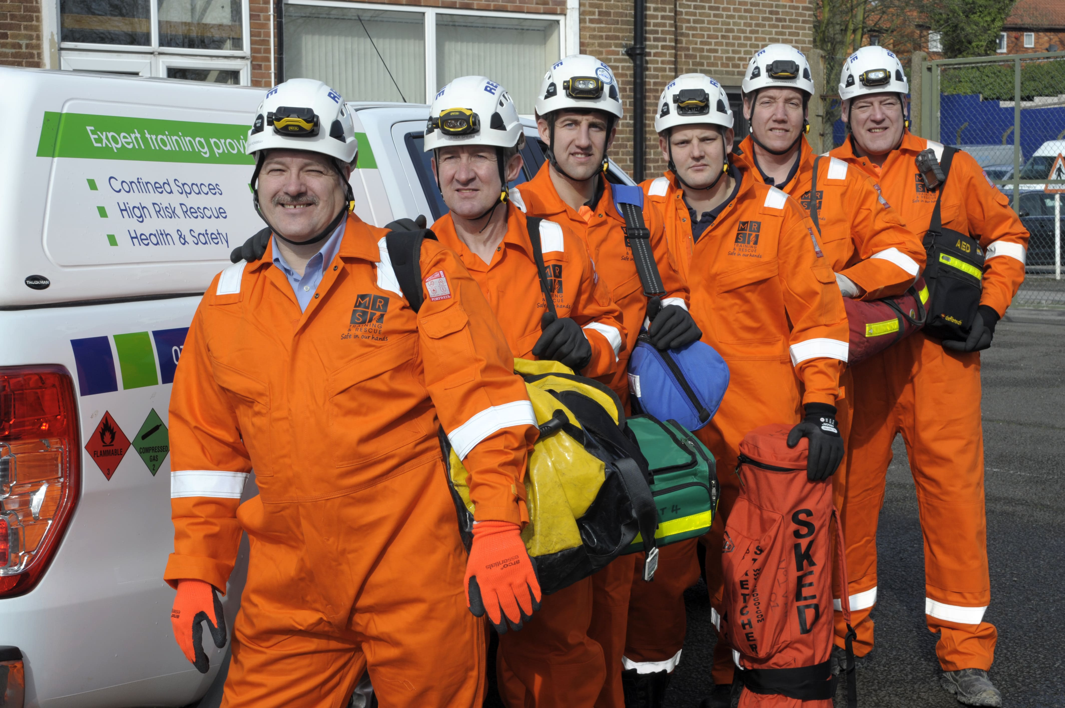

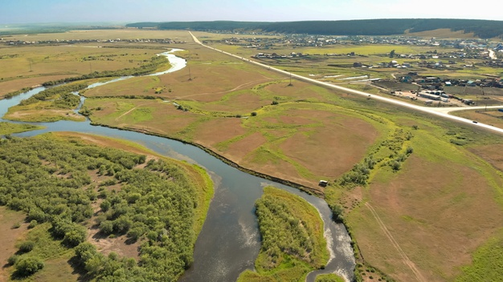
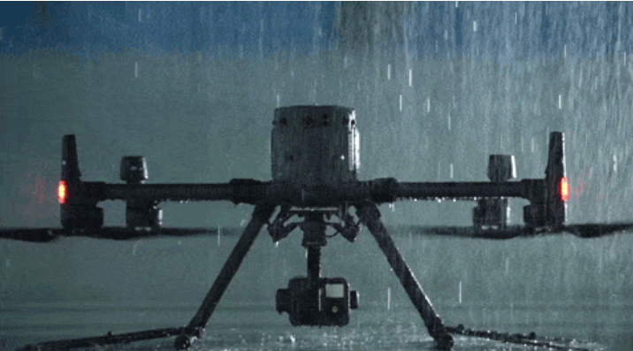
Background & Motivation

Slide 5
Background & Motivation

Slide 6
Background & Motivation

Slide 7
Background & Motivation

Slide 8
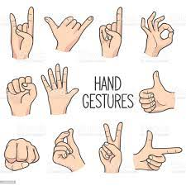
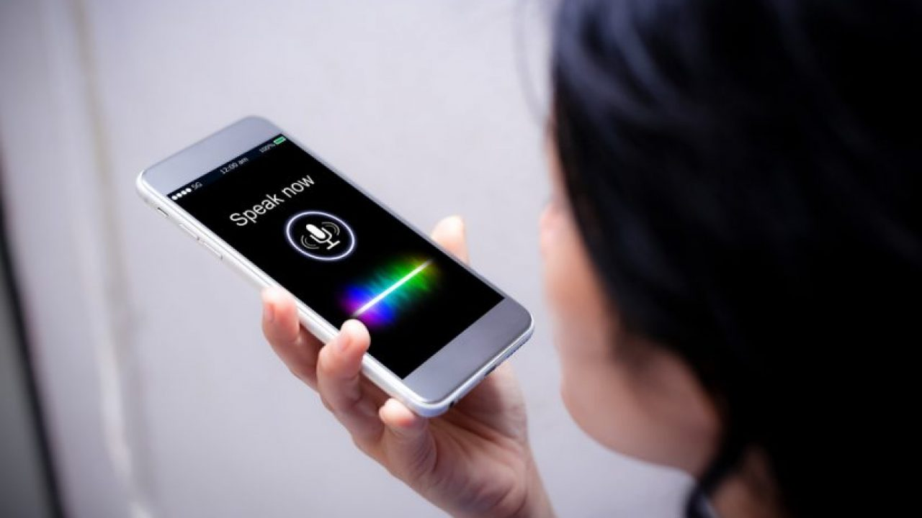
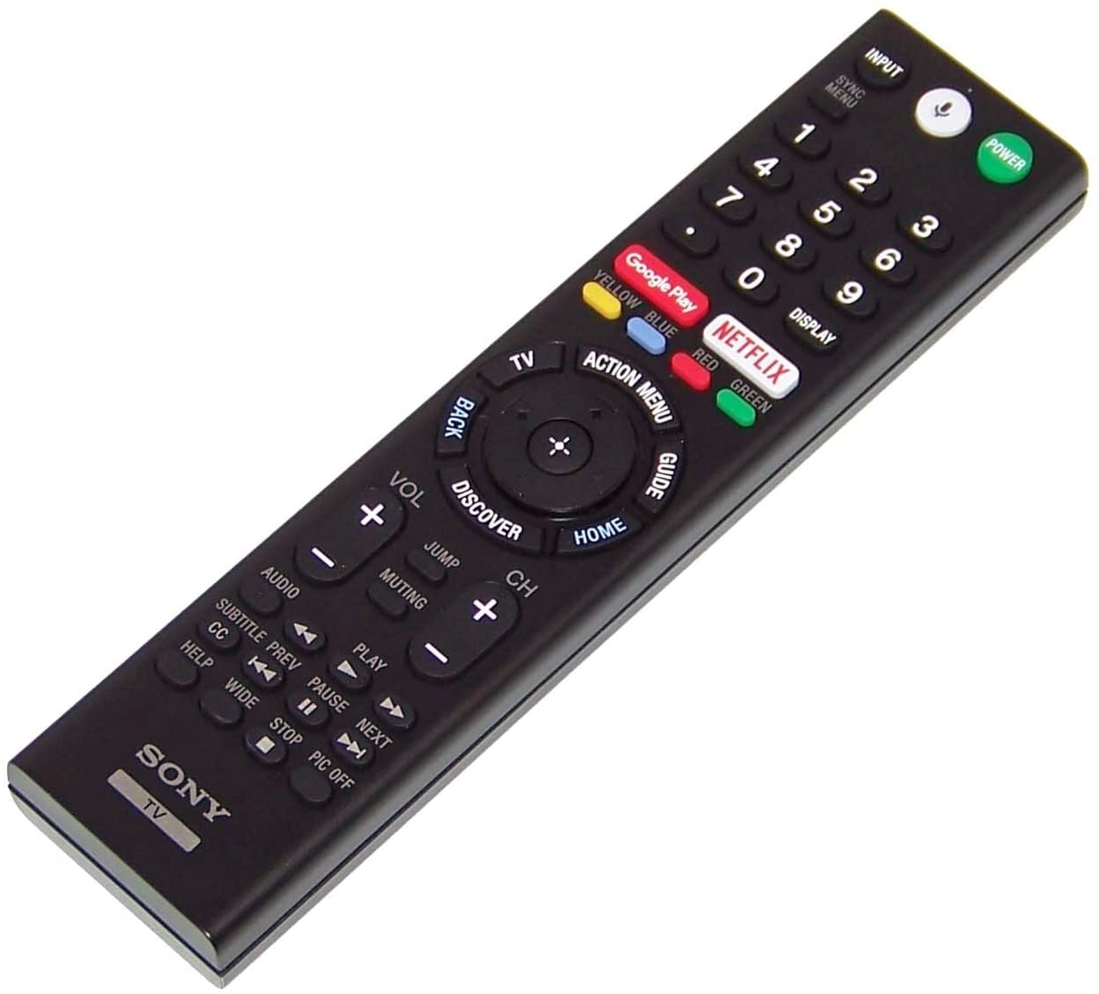
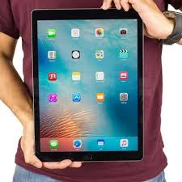
Background
Hand gestures
Voice control
Remote control
Touchpad
Notes:
Even so, in the last few years, encounters between human and drones are much more frequent.
That’s why its important to create a friendly communication system for people to interact with drones
There are a few ways to doing that, for example:
You can use a voice control – although it can be hard to receive the message properly, especially in loud environment
Another way to communicate is with a remote control – which require handing out and collecting the remote and that can harm the autonomy of the drone
You can also use a touchpad which require getting very close to drone, something that many people can get scared by and preferer to stay at least a meter away
And, you can use hand gestures – which are for most people natural and easy to preform, and you can base on common gestures such as straiting the hand forward like in a stop sign to stop the drone.
But we still need to consider how different people and cultures response to the drone and the level of their cooperation

Slide 9
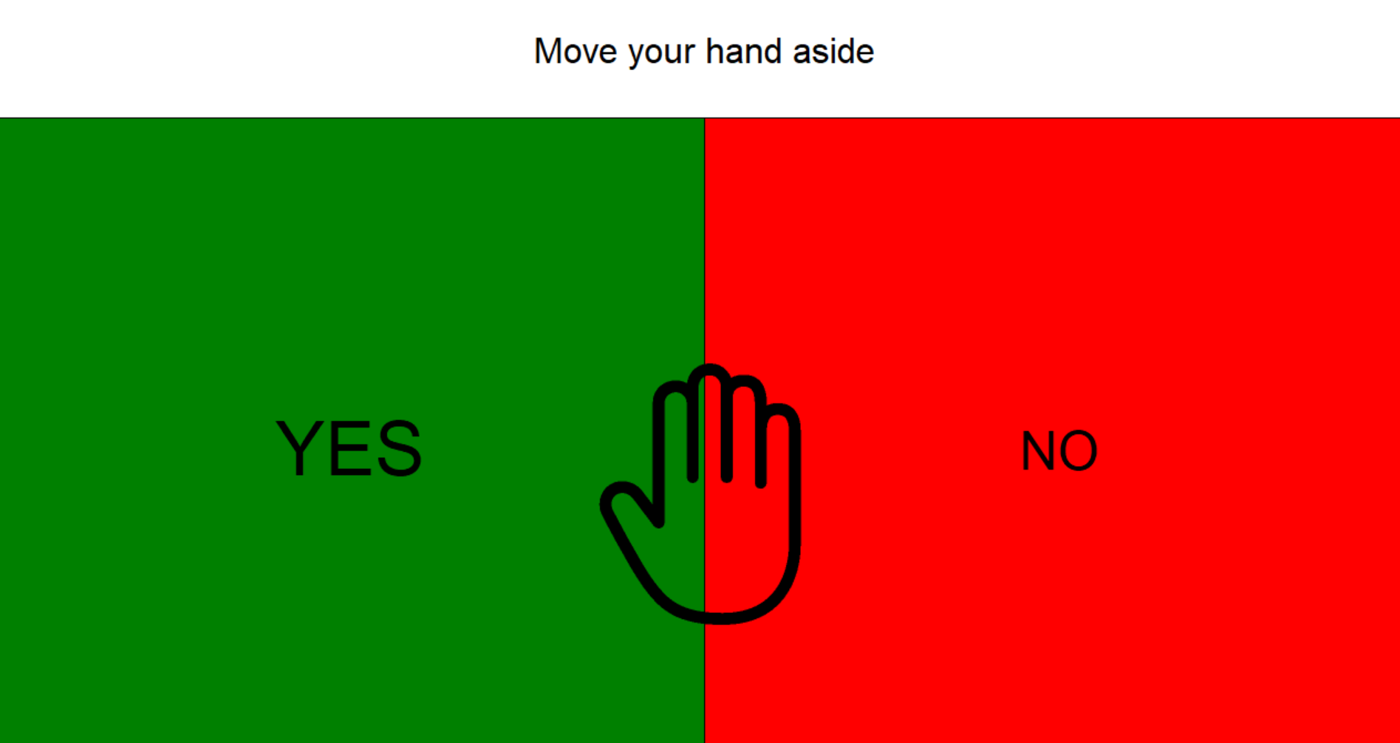
Planning
frame = pipeline.wait_for_frames() depth_frame = frame.get_depth_frame() color_frame = frame.get_color_frame() depth_image = np.asanyarray(depth_frame.get_data()) color_image = np.asanyarray(color_frame.get_data()) colorizer = rs.colorizer() colorized_depth = np.asanyarray(colorizer.colorize(depth_frame).get_data()) depth_colormap = cv2.applyColorMap(cv2.convertScaleAbs(depth_image, None, 0.175, 0), cv2.COLORMAP_JET)
Notes:
So in the planning phase:
As we said, this is a continuous project so we needed to fully understand the work done so far, the existing code, problems that can occur and what to pay attention to.
We needed to prepare all of the equipment for the project, especially because there are a lot of Special components needed.
Then we planed the structure of the interface, what kind of question we need to build so the user will easily understand what to do and how to answer and start planning the code
And lastly, we needed to understand what do we want to ask the injured person so we can understand the person condition best in a short time and for that we consulted 2 medical persons

Slide 10
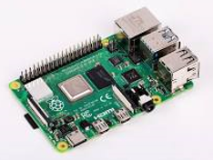
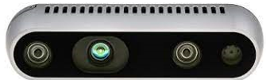
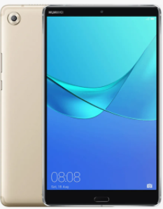
Equipment
Raspberry Pi 4
Intel RealSense D435
Huawei Mediapad M5
Notes:
in terms of the central equipment we used, we have the Intel depth camera with which we recognize the hand, a Raspberry Pi 4, which is actually the computer of the system on which the code and the operating rule are found, and a tablet screen on which the interface is displayed. And all these components are suitable for sitting on a drone.

Slide 11
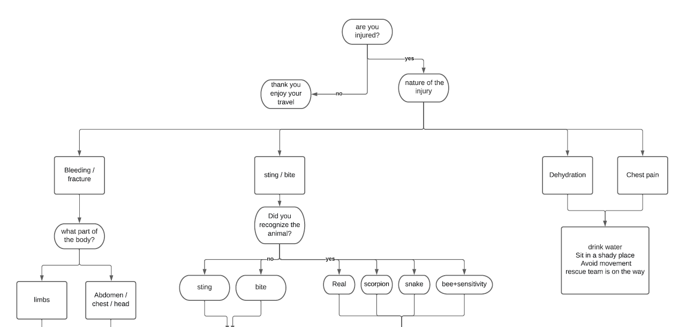
Notes:
So together with them we built a story line that customize the questions based on there previous answers
And accordingly, provide short instructions until the rescue team arrives

Slide 12
Implementing - Improving
Image Configuration change
Logical changing
Sensitivity
Notes:
What we did is firstly changing the image configuration to increase the detection rate
We improved the accuracy of the hand detection so the interface will run more smoothly and more responsive to the user
We have centered the location of the hand so when starting the first capture of the hand will calibrate the interface to the middle of the screen and every movement will be according to the starting point
We have also changed the logic of the interface so in each iteration when the hand is not detected the system will not count it as the preview detection but hold its position until next detection

Slide 13




Implementing - Improving
 | changes
after | before
 |  | Hand icon
 |  | Colors
rs.format.any | rs.format.z16 | Configuration
Image Configuration change
Improving hand recognition
Logical changing
Notes:
What we did is firstly changing the image configuration to increase the detection rate
We improved the accuracy of the hand detection so the interface will run more smoothly and more responsive to the user
We have centered the location of the hand so when starting the first capture of the hand will calibrate the interface to the middle of the screen and every movement will be according to the starting point
We have also changed the logic of the interface so in each iteration when the hand is not detected the system will not count it as the preview detection but hold its position until next detection

Slide 14
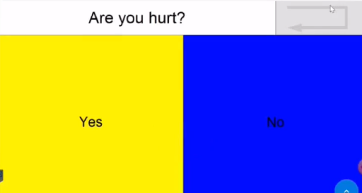
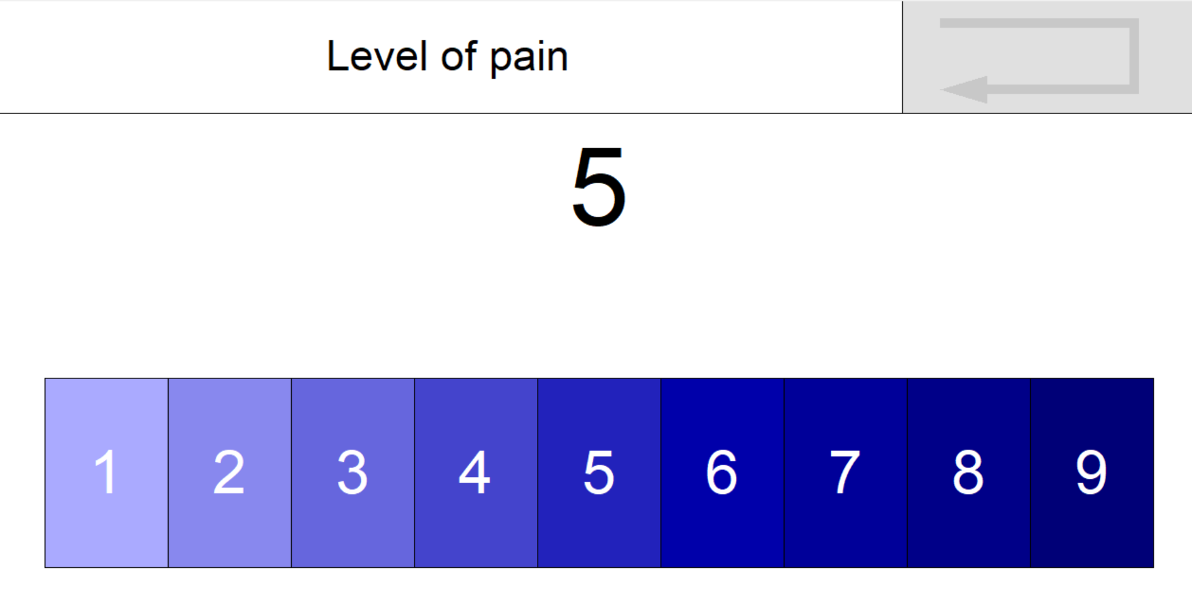
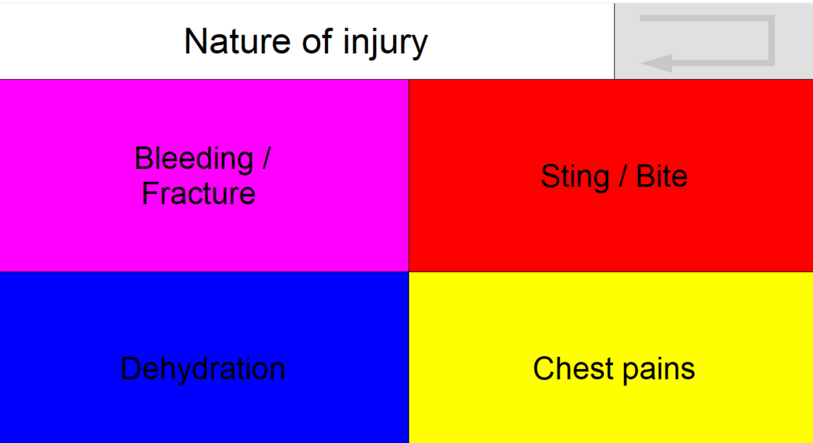
Implementing
Notes:
in The creation of the interface itself we firstly created the code structure of the screens , 2 answers, 4 answers and a scale questions and we added a return button if the user wants to change a preview answer

Slide 15
Implementing
Story line
Sequence
Guidelines
Additions
Notes:
In the second phase we created all of the questions based on the medical staff information, we arranged the question based on the decision tree we saw before
We created the response screen to give the injured person basic instructions and added images and video based on the person condition and the nature of injury
Like a video on how to stop a bleeding in case the person answered that he has a bleeding from his limps. or pictures of common snakes in the area incase he got bit, so we can provide the rescue team information about how to treat him

Slide 16
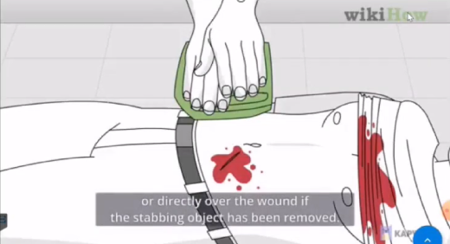

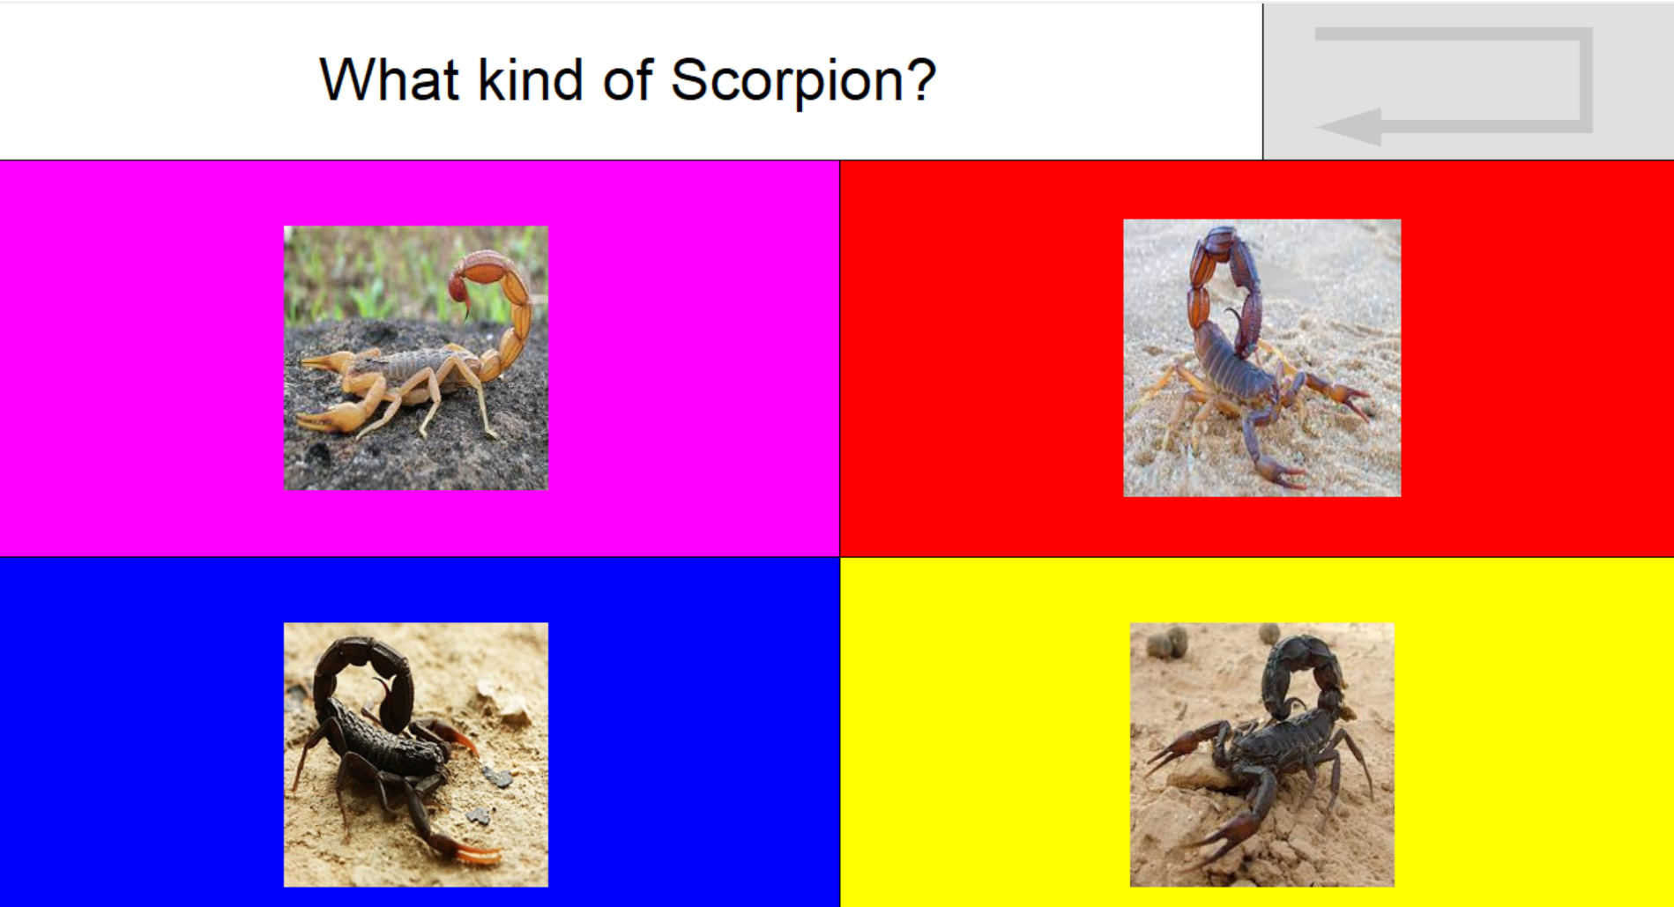
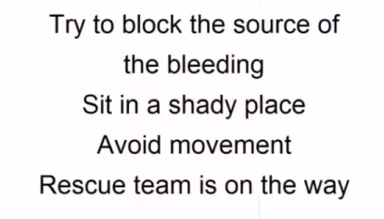
More functionalities

Slide 17
Code’ modularity
def __init__(self, *args:"text, type, answers", **kwargs): self._nameQ = args[0] self._text = args[1] self._type = args[2] self._answers = args[3] self._prevQ = args[4] self._nextQ = args[5] if ('ansimg' in kwargs.keys()): self._ansimg = kwargs['ansimg'] Questionair.append(Question Questionair.append(Question("Q8", "Level of pain", QT_RULLER, ['1\nLow','2','3','4','5','6','7','8','9\nHigh'], "Q1", ["Q2","Q2","Q2","Q2","Q2","Q2","Q2","Q2","Q2",])); Questionair.append(Question("Q2", "Nature of injury", QT_4ANS, ['Bleeding /\n Fracture ', 'Sting / Bite', 'Dehydration', 'Chest pains'], "Q1", ["Q3", "Q5","",""])); Questionair.append(Question("Q3", "What is your injury location?", QT_2ANS, ['Limbs', 'Other'], "Q2", ["Q4", ""])); Questionair.append(Question("Q4", "Bleeding or having a Fracture?", QT_2ANS, ['Bleeding', 'Fracture'], "Q3", ["", ""])); Questionair.append(Question("Q5", "Did you recognize the animal?", QT_4ANS, ['Snake', 'Scorpion', 'Bee + sensitivity', "Other / \nDon't know"], "Q2", ["Q6", "Q7", "", ""]));
Notes:
So in the planning phase:
As we said, this is a continuous project so we needed to fully understand the work done so far, the existing code, problems that can occur and what to pay attention to.
We needed to prepare all of the equipment for the project, especially because there are a lot of Special components needed.
Then we planed the structure of the interface, what kind of question we need to build so the user will easily understand what to do and how to answer and start planning the code
And lastly, we needed to understand what do we want to ask the injured person so we can understand the person condition best in a short time and for that we consulted 2 medical persons

Slide 18
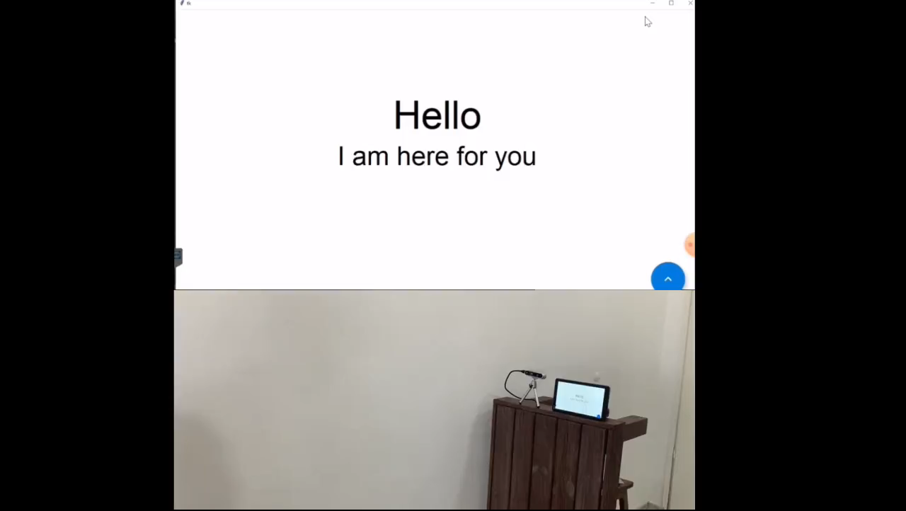

Slide 19
Conclusions
Working interface, highly modular, easily adjustable.
The project has reached his goals
Further work - test the interface mounted on a drone
Improvements always possible
Notes:
In conclusion – we have built a working modular interface that can easily adjust to different languages and areas with different wildlife
We have managed to reach our goals for the project, the interface is working smoothly on a raspberry pi and can be portable
Due to covid and the security state in the country we didn’t managed to test the system on a drone in the air and this can be done in later time

Slide 20
Bibliography
[6] C. Shimanski, “Situational Awareness in Search and Rescue Operations,” Mt. Rescue Assoc. Educ. Comm., no. July, 2008.
[7] S. Mayer, L. Lischke, and P. W. Woźniak, “Drones for Search and Rescue,” 1st Int. Work. Human- Drone Interact., 2019.
[11] P. Zhu, L. Wen, X. Bian, H. Ling, and Q. Hu, “Vision meets drones: A challenge,” arXiv, pp. 1–11, 2018.
[12] P. Rudol and P. Doherty, “Human body detection and geolocalization for UAV search and rescue missions using color and thermal imagery,” IEEE Aerosp. Conf. Proc., 2008, doi: 10.1109/AERO.2008.4526559.
[13] H. Brändström, O. Winsö, L. Lindholm, and M. Haney, “Regional intensive care transports: A prospective analysis of distance, time and cost for road, helicopter and fixed-wing ambulances,” Scand. J. Trauma. Resusc. Emerg. Med., vol. 22, no. 1, pp. 1–8, 2014, doi: 10.1186/1757-7241-22-36.
[14] Y. Karaca et al., “The potential use of unmanned aircraft systems (drones) in mountain search and rescue operations,” Am. J. Emerg. Med., vol. 36, no. 4, pp. 583–588, 2018, doi: 10.1016/j.ajem.2017.09.025.
[16] R. A. S. Fernandez, J. L. Sanchez-Lopez, C. Sampedro, H. Bavle, M. Molina, and P. Campoy, “Natural user interfaces for human-drone multi-modal interaction,” 2016 Int. Conf. Unmanned Aircr. Syst. ICUAS 2016, pp. 1013–1022, 2016, doi: 10.1109/ICUAS.2016.7502665.
[17] J. Vanus, M. Smolon, R. Martinek, J. Koziorek, J. Zidek, and P. Bilik, “Testing of the voice communication in smart home care,” Human- centric Comput. Inf. Sci., vol. 5, no. 1, 2015, doi: 10.1186/s13673-015-0035-0.
[18] X. Han and M. A. Rashid, “Gesture and voice control of Internet of Things,” Proc. 2016 IEEE 11th Conf. Ind. Electron. Appl. ICIEA 2016, pp. 1791–1795, 2016, doi: 10.1109/ICIEA.2016.7603877.

Slide 21
[19] F.-W. Mini-uavs, M. A. Goodrich, and R. W. Beard, “Semi-Autonomous Human-UAV Interfaces for,” pp. 2457–2462, 2004.
[20] V. M. Monajjemi, J. Wawerla, R. Vaughan, and G. Mori, “HRI in the sky: Creating and commanding teams of UAVs with a vision-mediated gestural interface,” IEEE Int. Conf. Intell. Robot. Syst., pp. 617–623, 2013, doi: 10.1109/IROS.2013.6696415.
[21] M. Lichtenstern, M. Angermann, and M. Frassl, “IMU- and GNSS-assisted single-user control of a MAV-swarm for multiple perspective observation of outdoor activities,” Inst. Navig. - Int. Tech. Meet. 2011, ITM 2011, vol. 2, no. January, pp. 1062–1069, 2011.
[22] S. Rajappa, H. Bülthoff, and P. Stegagno, “Design and implementation of a novel architecture for physical human-UAV interaction,” Int. J. Rob. Res., vol. 36, no. 5–7, pp. 800–819, 2017, doi: 10.1177/0278364917708038.
[23] C. Resources, “Us Ing the Ne W B a S a Ls To Te a Ch the W Riting Proce S S : Modif Ications F or,” Proc. SIGCHI Conf. Hum. Factors Comput. Syst., pp. 75–92, 2016.
[24] P. Abtahi, D. Zhao, J. E., and J. Landay, “Drone Near Me: Exploring Touch-Based Human-Drone Interaction,” Proc. ACM Interactive, Mobile, Wearable Ubiquitous Technol., vol. 1, no. 3, pp. 1–8, 2017, doi: 10.1145/3130899.
[25] J. Nagi, A. Giusti, G. A. Di Caro, and L. M. Gambardella, “Human Control of UAVs using Face Pose Estimates and Hand Gestures,” Proc. 2014 ACM/IEEE Int. Conf. Human-robot Interact. - HRI ’14, no. c, pp. 252–253, 2014, [Online]. Available: http://dl.acm.org/citation.cfm?doid=2559636.2559833.
[26] A. Sanna, F. Lamberti, G. Paravati, and F. Manuri, “A Kinect-based natural interface for quadrotor control,” Entertain. Comput., vol. 4, no. 3, pp. 179–186, 2013, doi: 10.1016/j.entcom.2013.01.001.
[27] W. S. Ng and E. Sharlin, “Collocated interaction with flying robots,” Proc. - IEEE Int. Work. Robot Hum. Interact. Commun., pp. 143–149, 2011, doi: 10.1109/ROMAN.2011.6005280.
[28] J. R. Cauchard, L. E. Jane, K. Y. Zhai, and J. A. Landay, “Drone & Me : A n Exploration I nto Natural Human - D rone Interaction.”
[31] M. Oudah, A. Al-Naji, and J. Chahl, “Hand Gesture Recognition Based on Computer Vision: A Review of Techniques,” J. Imaging, vol. 6, no. 8, 2020, doi: 10.3390/JIMAGING6080073.

Slide 22
Questions?

